Slide 1

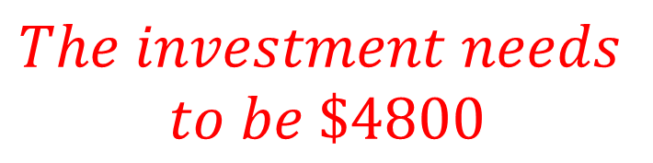




Example 8
How much money needs to be invested for 3 years at 6% simple interest to earn interest of $864?
Using $I=PrT$
Given $I=864, r=0.06, T=3$
$$864=P×0.06×3$$
$$864=0.18P$$
$$The investment needs$$
$$to be \$4800$$
$$\frac{864}{0.18}=P$$
$$4800=P$$

Slide 2

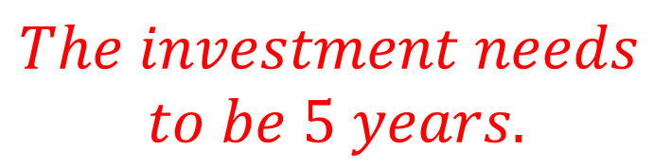




Example 9
How long does an investment of $12 500 need to be invested at 3.8% per annum simple interest to earn interest of $2375?
Using $I=PrT$
Given $I=2375, r=0.038, P=12500$
$$2375=12500×0.038×T$$
$$2375=475T$$
$$\frac{2375}{475}=T$$
$$The investment needs$$
$$to be 5 years.$$
$$5=T$$

Slide 3




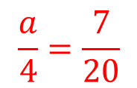
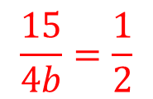
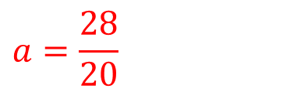
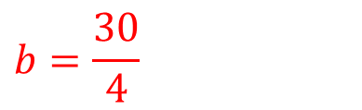


Example 10
Find the value of a and b in the following
a) $a:4=7:20$ b) $15:4b=1:2$
$$\frac{15}{4b}=\frac{1}{2}$$
$$\frac{a}{4}=\frac{7}{20}$$
$$15×2=1×4b$$
$$20×a=7×4$$
$$30=4b$$
$$20a=28$$
$$b=\frac{30}{4}$$
$$a=\frac{28}{20}$$
$$a=7.5$$
$$a=1.4$$

Slide 4
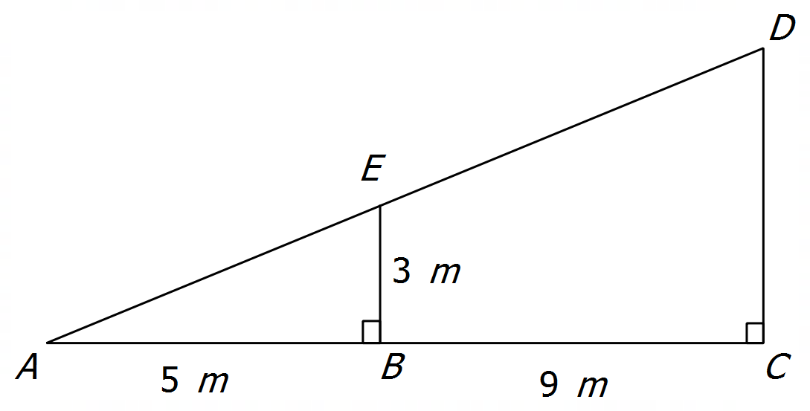


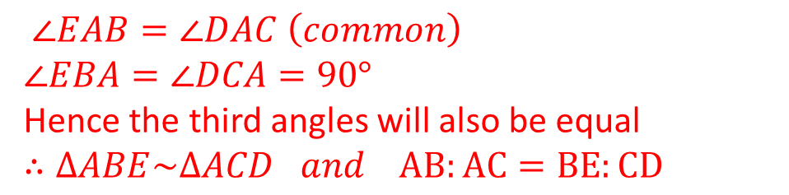

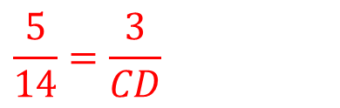
Example 11
In the diagram shown on the right AB = 5m, BC = 9m, and BE = 3m. Find the length of CD, justifying your answer.
$∠EAB=∠DAC \left(common\right)$
$$∠EBA=∠DCA=90°$$
Hence the third angles will also be equal
$$∴∆ABE\sim ∆ACD and AB:AC=BE:CD$$
$$5:14=3:x$$
$$\frac{5}{14}=\frac{3}{CD}$$
$$5(CD)=42$$
$$CD=8.4m$$

Slide 5
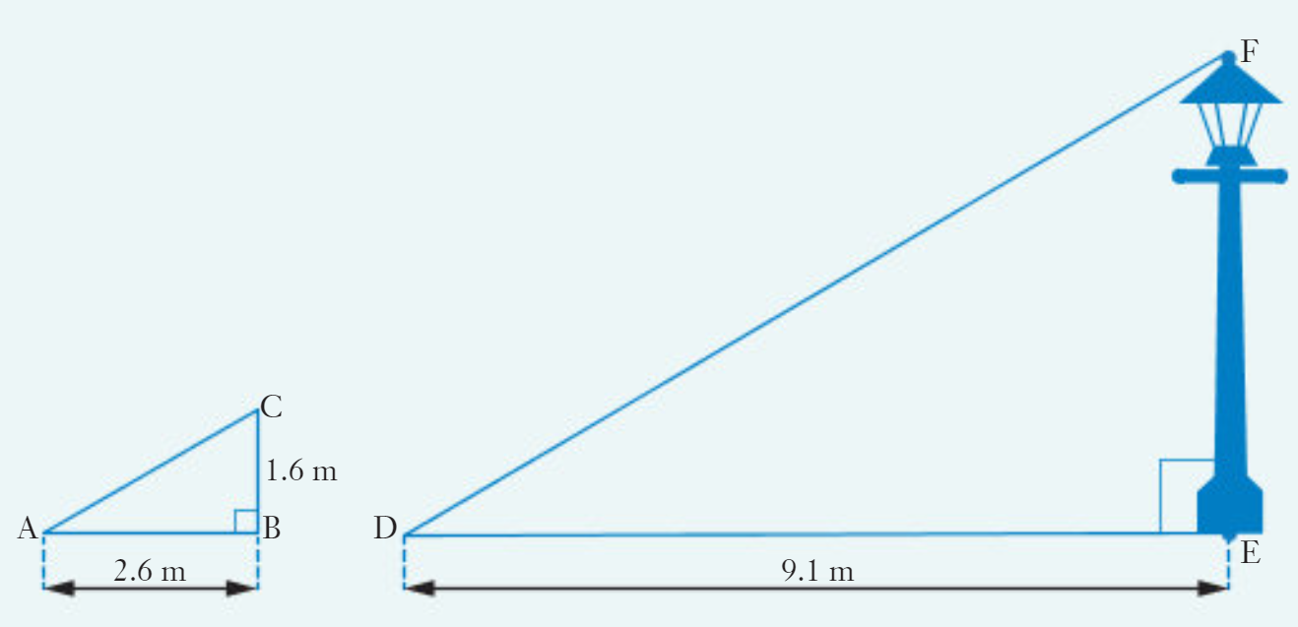


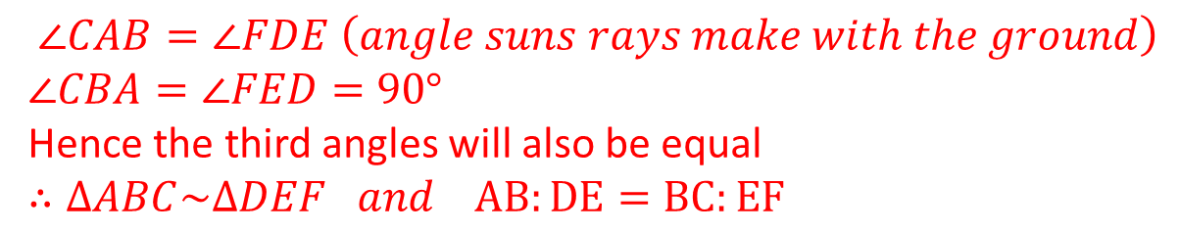

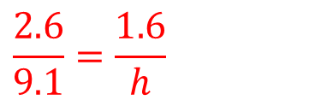
Example 7
Now do Exercise 7D
How tall is the street light?
On a sunny day, at the same time that a street light standing on horizontal ground casts a shadow of length 9.1 metres, a 1.6 metre stick held vertically on the same ground cast a shadow of length 2.6 metres.
$∠CAB=∠FDE \left(angle suns rays make with the ground\right)$
$$∠CBA=∠FED=90°$$
Hence the third angles will also be equal
$$∴∆ABC\sim ∆DEF and AB:DE=BC:EF$$
$$2.6:9.1=1.6:h$$
$$\frac{2.6}{9.1}=\frac{1.6}{h}$$
$$2.6h=14.56$$
$$h=5.6m$$

